Slide 1
Stats for AI
Rishabh Kumar

Slide 2

Topics to cover
Summarising Statistics
Probability Theory
Bayes Theorem
Distributions
Samples
Hypothesis Testing
Comparing means
Linear Regression
What is AI
Simple ML Overview
Deep Learning Overview
Reinforcement Learning Overview

Slide 3
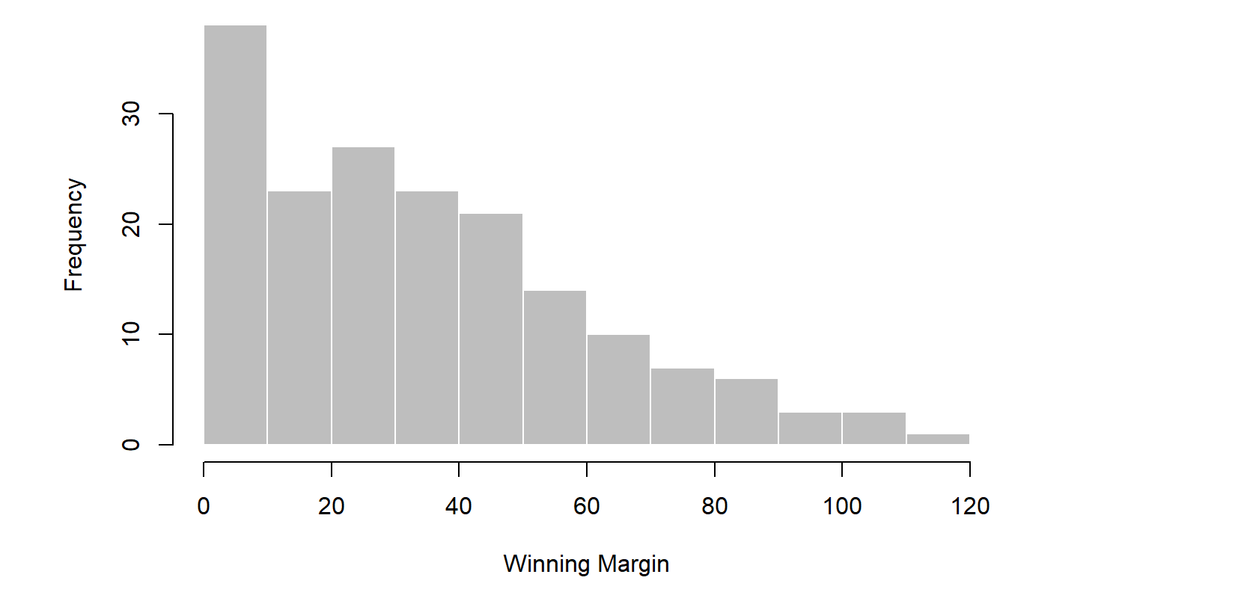
Data

Slide 4
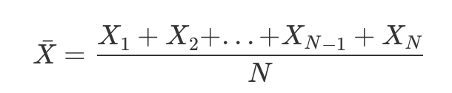


Mean
the observation | its symbol | the observed value
winning margin, game 1 | X1 | 56 points
winning margin, game 2 | X2 | 31 points
winning margin, game 3 | X3 | 56 points
winning margin, game 4 | X4 | 8 points
winning margin, game 5 | X5 | 32 points

Slide 5

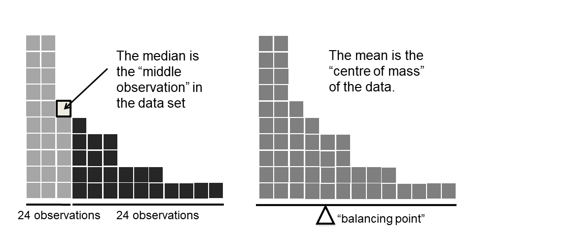
Median

Slide 6
Bankers using mean and median
Senior Commonwealth Bank executives have travelled the world in the past couple of weeks with a presentation showing how Australian house prices, and the key price to income ratios, compare favourably with similar countries. “Housing affordability has actually been going sideways for the last five to six years,” said Craig James, the chief economist of the bank’s trading arm, CommSec.
CBA has waged its war against what it believes are housing doomsayers with graphs, numbers and international comparisons. In its presentation, the bank rejects arguments that Australia’s housing is relatively expensive compared to incomes. It says Australia’s house price to household income ratio of 5.6 in the major cities, and 4.3 nationwide, is comparable to many other developed nations. It says San Francisco and New York have ratios of 7, Auckland’s is 6.7, and Vancouver comes in at 9.3.
Many analysts say that has led the bank to use misleading figures and comparisons. If you go to page four of CBA’s presentation and read the source information at the bottom of the graph and table, you would notice there is an additional source on the international comparison – Demographia. However, if the Commonwealth Bank had also used Demographia’s analysis of Australia’s house price to income ratio, it would have come up with a figure closer to 9 rather than 5.6 or 4.3
[An] obvious problem with the Commonwealth Bank’s domestic price to income figures is they compare average incomes with median house prices (unlike the Demographia figures that compare median incomes to median prices). The median is the mid-point, effectively cutting out the highs and lows, and that means the average is generally higher when it comes to incomes and asset prices, because it includes the earnings of Australia’s wealthiest people. To put it another way: the Commonwealth Bank’s figures count Ralph Norris’ multi-million dollar pay packet on the income side, but not his (no doubt) very expensive house in the property price figures, thus understating the house price to income ratio for middle-income Australians.

Slide 7
Trimmed Mean
Cut the extremes
Group A = -100, 3,5,7,20
Group B = - 15,0,1,4,7,12
Highly sensitive to one or two extreme values, and is thus not considered to be a robust measure.
Mode
The mode of a sample is very simple: it is the value that occurs most frequently

Slide 8
Measures of Variability
Range
The range of a variable is the biggest value minus the smallest value.
Interquartile range
The interquartile range (IQR) is the difference between the 25th quantile and the 75th quantile. Probably you already know what a quantile
It is like the range, but instead of calculating the difference between the biggest and smallest value it focuses on 25th and 7th quantiles

Slide 9
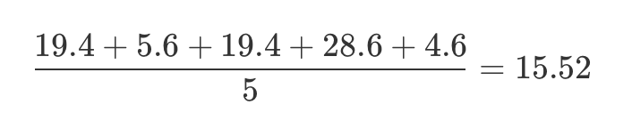

Mean absolute deviation
A different approach is to select a meaningful reference point (usually the mean or the median) and then report the “typical” deviations from that reference point
the observation | its symbol | the observed value
winning margin, game 1 | X1 | 56 points
winning margin, game 2 | X2 | 31 points
winning margin, game 3 | X3 | 56 points
winning margin, game 4 | X4 | 8 points
winning margin, game 5 | X5 | 32 points

Slide 10
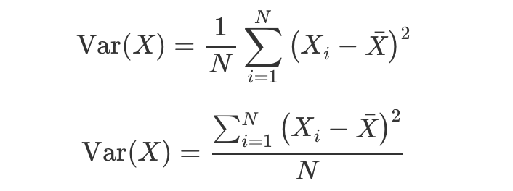
Variance and standard deviation
$$(σ^{2})$$
$$(σ)$$
Squared mean deviation
i | Xi Value | Xi - mean | (Xi - mean)^2
1 | 56 | 19.4 | 376.36
2 | 31 | -5.6 | 31.36
3 | 56 | 19.4 | 376.36
4 | 8 | -28.6 | 817.96
5 | 32 | -4.6 | 21.16
$$σ^{2}=\frac{\overset{n}{\underset{i=1}{∑}}(x_{i}-μ)^{2}}{n}$$
Z = A + B
Var(Z) = Var(A) + Var(B)

Slide 11
Standard Scores or z scores
A different approach is to convert my grumpiness score into a standard score, also referred to as a z score
z score. The standard score is defined as the number of standard deviations above the mean that my grumpiness score lies.
$$standardscore=\frac{(rawscore-mean)}{σ}$$
$$z_{i}=\frac{(35-17)}{5}=3.6$$
$$z_{i}=\frac{(X_{i}-\overline{X})}{\overset{̂}{σ}}$$

Slide 12
Correlations

Slide 13
Probability Theory
Inferential statistics provides the tools that we need to answer these sorts of questions, and since these kinds of questions lie at the heart of the scientific enterprise.
However, the theory of statistical inference is built on top of probability theory
All statistical theory is built upon probability but most staticians dont agree what probability is

Slide 14
What is probability
They’re robot teams, so I can make them play over and over again, and if I did that, Arduino Arsenal would win 8 out of every 10 games on average. [Odds]
For any given game, I would only agree that betting on this game is only “fair” if a $1 bet on C Milan gives a $5 payoff (i.e. I get my $1 back plus a $4 reward for being correct), as would a $4 bet on Arduino Arsenal (i.e., my $4 bet plus a $1 reward). [Expectations]
My subjective “belief” or “confidence” in an Arduino Arsenal victory is four times as strong as my belief in a C Milan victory [Beliefs]

Slide 15
Frequentist
The more dominant view in statistics, is referred to as the frequentist view, and it defines probability as a long-run frequency.

Slide 16
Pros
Firstly, it is objective: the probability of an event is necessarily grounded in the world. The only way that probability statements can make sense is if they refer to (a sequence of) events that occur in the physical universe.
Secondly, it is unambiguous: any two people watching the same sequence of events unfold, trying to calculate the probability of an event
Firstly, infinite sequences don’t exist in the physical world.
The frequentist definition has a narrow scope. Frequentist probability genuinely forbids us from making probability statements about a single event.
“There is a category of days for which I predict a 60% chance of rain; if we look only across those days for which I make this prediction, then on 60% of those days it will actually rain”
Cons

Slide 17
Bayesian
The Bayesian view of probability is often called the subjectivist view, and it is a minority view among statisticians, but one that has been steadily gaining traction for the last several decades.
The most common way of thinking about subjective probability is to define the probability of an event as the degree of belief that an intelligent and rational agent assigns to that truth of that event.
The main advantage is that it allows you to assign probabilities to any event you want to. You don’t need to be limited to those events that are repeatable.
The main disadvantage (to many people) is that we can’t be purely objective – specifying a probability requires us to specify an entity that has the relevant degree of belief. This entity might be a human, an alien, a robot, or even a statistician, but there has to be an intelligent agent out there that believes in things.
To many people this is uncomfortable: it seems to make probability arbitrary.

Slide 18
Bayesian
From a Bayesian perspective, statistical inference is all about belief revision.
I start out with a set of candidate hypotheses Hs about the world.
I don’t know which of these hypotheses is true, but do I have some beliefs about which hypotheses are plausible and which are not.
When I observe the data I have to revise those beliefs

